Slide 1
Housing Prices Prediction
Presented by
Name: P.ANAND
College: St.Peter’s college of engineering and technology
Department: CIVIL

Slide 2
OUTLINE
• Introduction
• Problem Statement
• Dataset• Pipeline
• Data cleaning• Feaue engineering
• Model creation
•Grid Search cross validation
• Result/Output

Slide 3
INTRODUCTION
• In this project, we have built machine learningmodel to predict the house prices.
• Housing sales price are determined by numerous factors such as material quality, living area square feet Size of garage, location of the house number of bedrooms and so on. We will apply numerous regression models and find out the most optimal , model with maximum R-square value

Slide 4
PROBLEM STATEMENT
Real estate is not only the key sector of the national economy, but also one of the citizen’s major concerns.
With increasing demand of housing , prices of houses are also getting up.
It is critical to provide accurate predictions of housing prices.

Slide 5
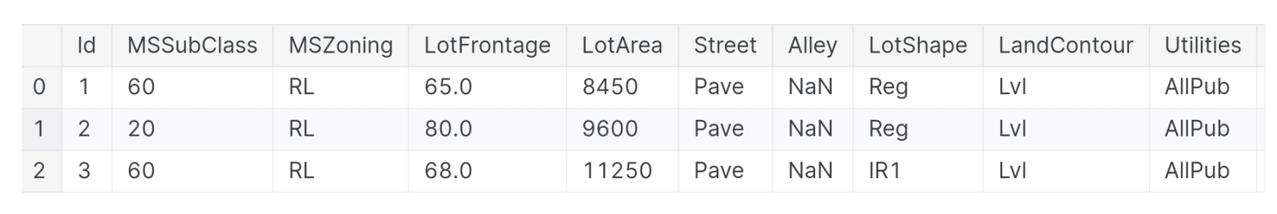
DATASET
Dataset comes from Kaggle.com.
Link to dataset:
https://www.kaggle.com/c/house-prices-advanced-regression-techniques/data

Slide 6
PIPELINE
Importing Libraries
Data Exploratian
Data Cleaning
Feature Engineering
Grid search cross
Validation
Optimal Model Creation
Creating submission tile

Slide 7
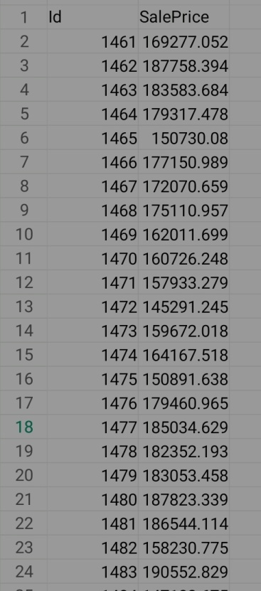
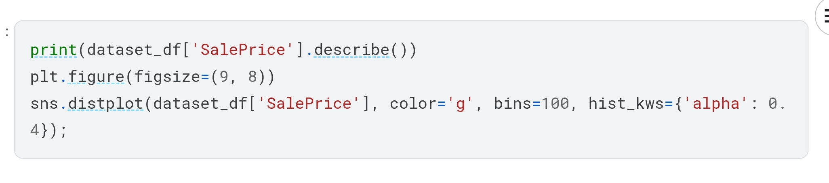
FEATURE CO-RELATION MATRIX

Slide 8
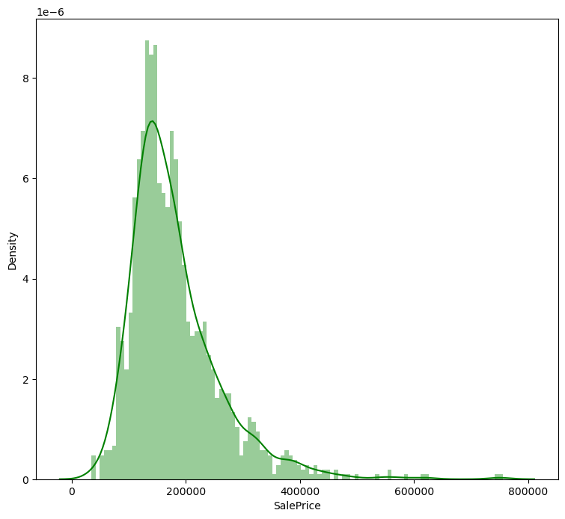
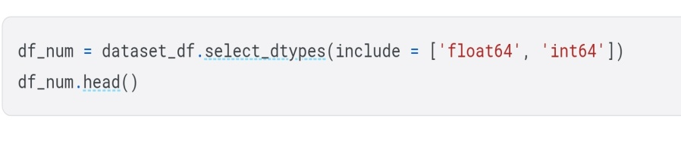
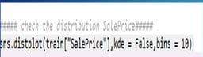
DISTRIBUTION OF TARGET VARIABLE

Slide 9
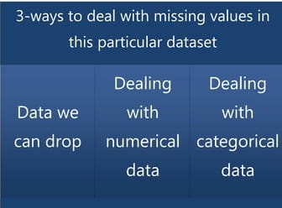
DEALING WITH MISSING VALUE

Slide 10
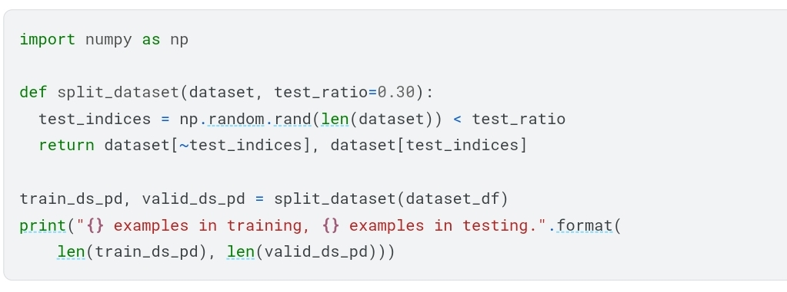
DROPPING MISSING VALUE
We notice that few feature have missing values that are really missing. That means that specific house doesn't have that feature. So, we can drop those columns as follow:

Slide 11
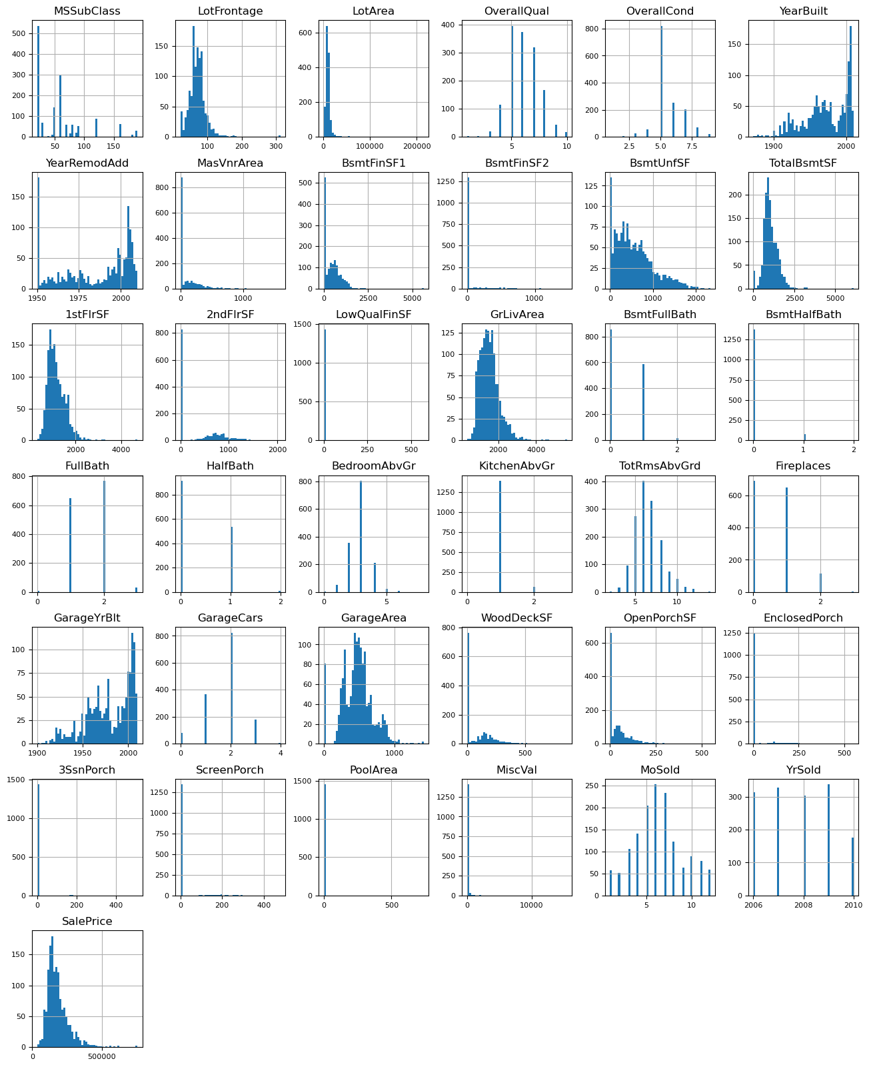
DEALING WITH CATEGORICAL DATA
While filling categories values , we have different techniques.

Slide 12
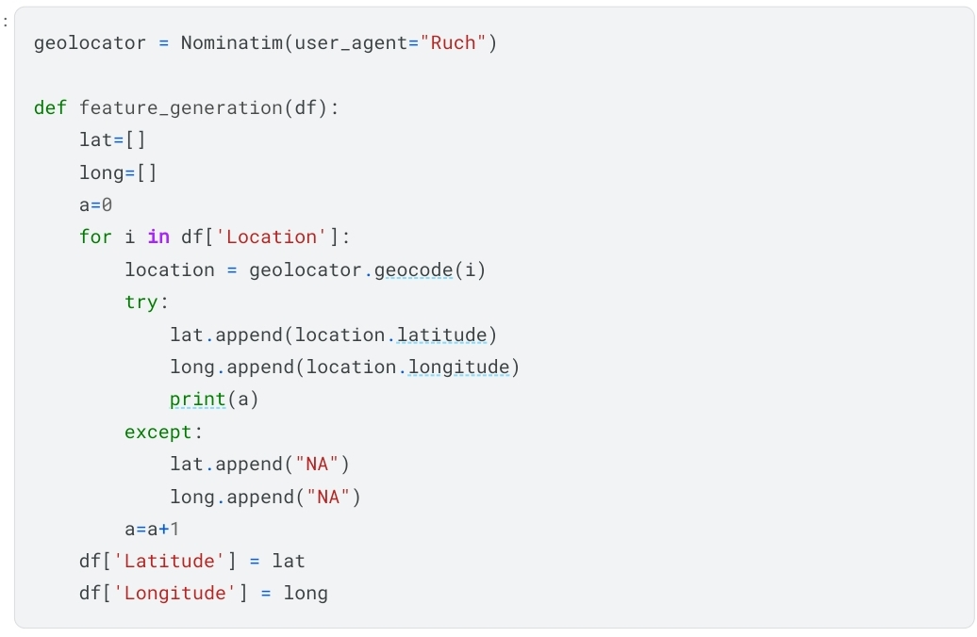
FEATURE ENGINEERING:

Slide 13
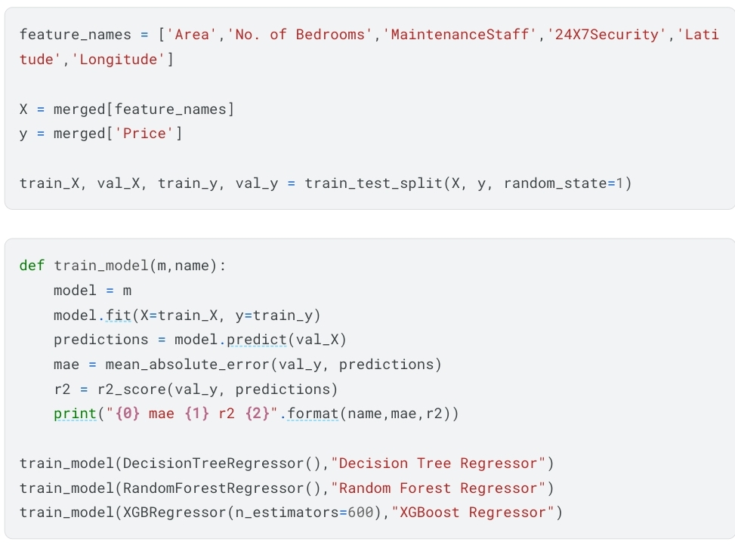
MODEL SELECTION
Random forest model has
highest value of R- square .
So, we can conclude that random
forest model is the most
optimal model for this dataset

Slide 14
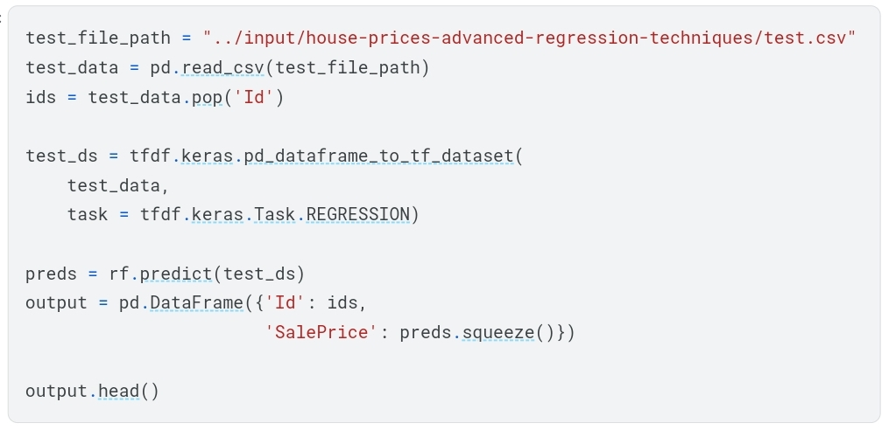
CREATION OF FINAL SUBMISSION

Slide 15
THANKYOU

